Slide 1

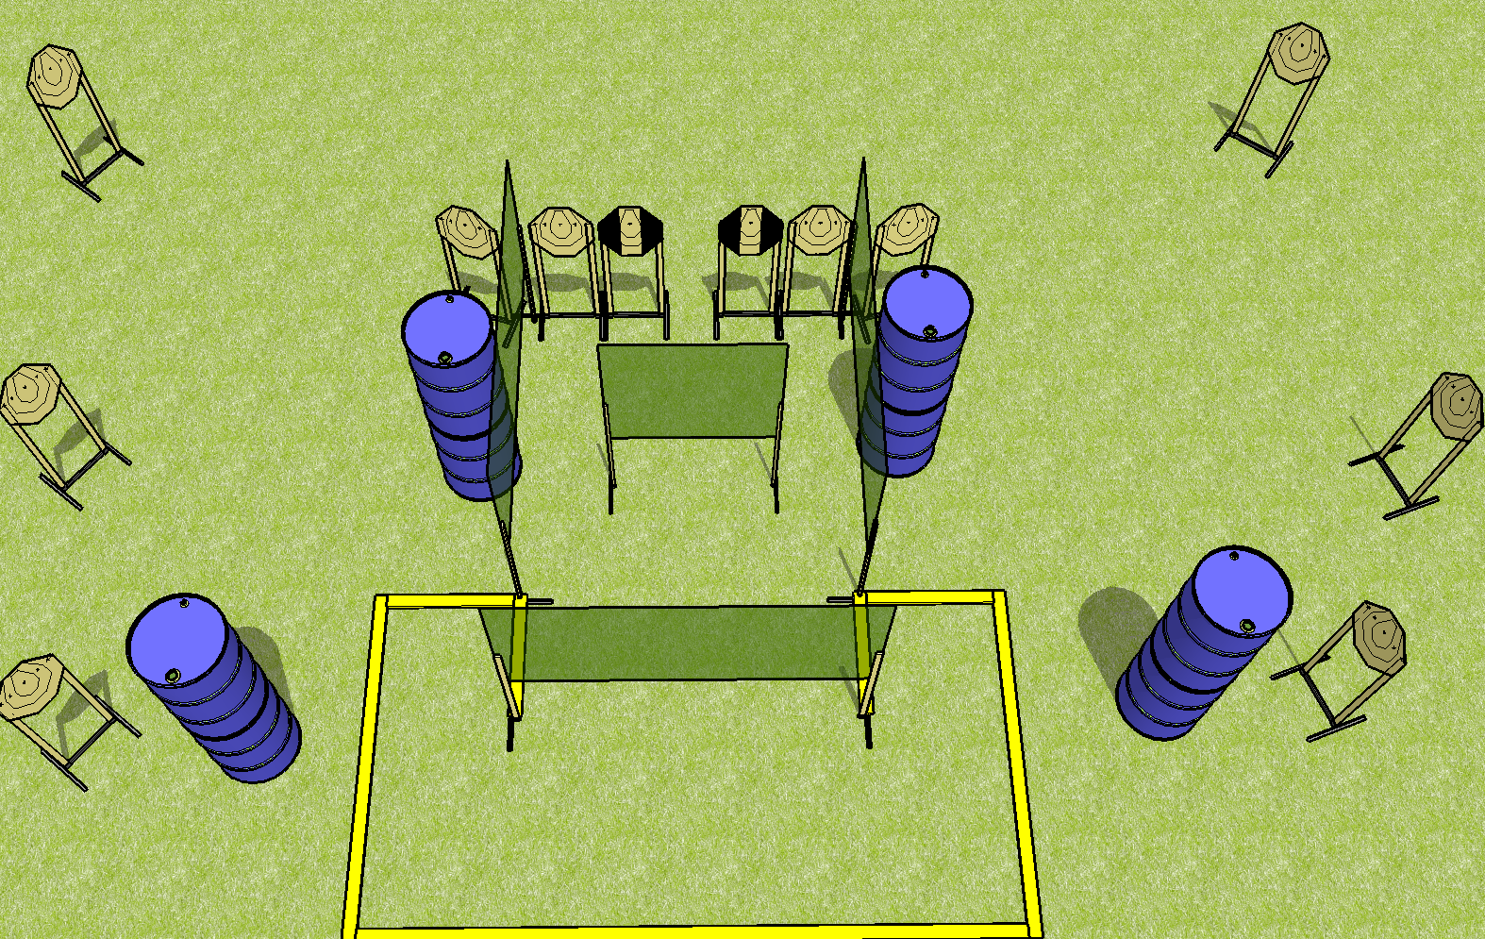
 | Dothan Practical Shooters – USPSA Match All the Single Turtles Course Designer : Drew Coleman Bay: B3
Round Count 12 rounds 12 IPSC
Equipment List 8 wall feet 2 tux 12 targets (10 + 2NS)

Slide 2
All the Single Ladies
Written Stage Briefing
Scoring: Comstock Rounds: 12
Targets: 12 IPSC
Best 1 hit per target
Handgun start position: anywhere completely outside the shooting area, wrists above shoulders. Handgun is loaded and holstered.
PCC start position: anywhere completely outside the shooting area, wrists above shoulders. Loaded carbine is held with both hands.
Stage Procedure: on the audible start signal, engage targets as they become available from within the shooting area.

